Slide 1
JAVA, JEE Training JDBC
Java Database Connectivity API
Harinath Mallepally
harinath@careerscale.in
Notes:
IMPORTANT – PLEASE READ.
Use this template to create your online courses. Change the template as you see fit, including the logo, images and copyright information. Add your speaker's notes to the Notes section of the PowerPoint (e.g. THIS SECTION) and then submit it to Dual Code's PowerFlash service.
Your PowerPoint will be converted to a Flash-based eLearning module or presentation. A professional voice-over artist will read you speaker’s notes and incorporate the resulting audio files in the Flash course. You will also have the option to save the course to a standard (Flash + HTML) format or SCORM compliant package so you can deploy it in your Learning Management System of choice.
Try it for FREE. Visit http://www.dualcode.com/elearning/powerflash.htm for more details.

Slide 2
Basics
import java.sql.*;
Connection
Statement/PreparedStatement/CallableStatement
ResultSet

Slide 3
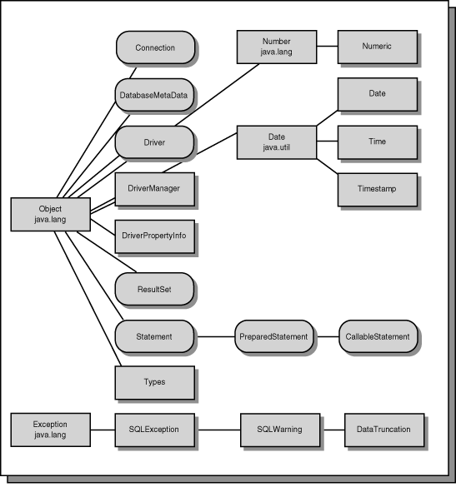

Slide 4
Transaction properties
ACID
Atomicity
Consistency
Isolation
Durability

Slide 5
Procedures and functions
You can write logic at the database level.
Standard SQL doesn't support scope for programming logic. Procedures and functions are extensions to support logic.
for simpler logic we use functions. functions have a return type where as procedures do not.
procedures support IN, OUT, INOUT parameters. OUT parameters allow you to return multiple values.

Slide 6
procedure - steps
Default delimiter is ; because we use it in regular SQL statement and because stored procedure needs lot of regular SQL statements, we need to re-define default delimiter to something else, here we go for //
procedure has IN, OUT, INOUT parameters
See the java code on how to call a procedure

Slide 7
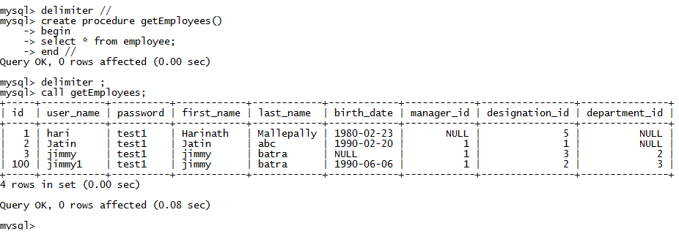
Procedure

Slide 8
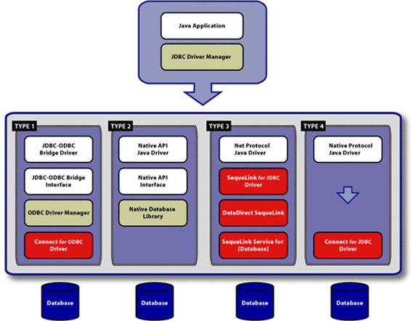
JDBC Drivers

Slide 9
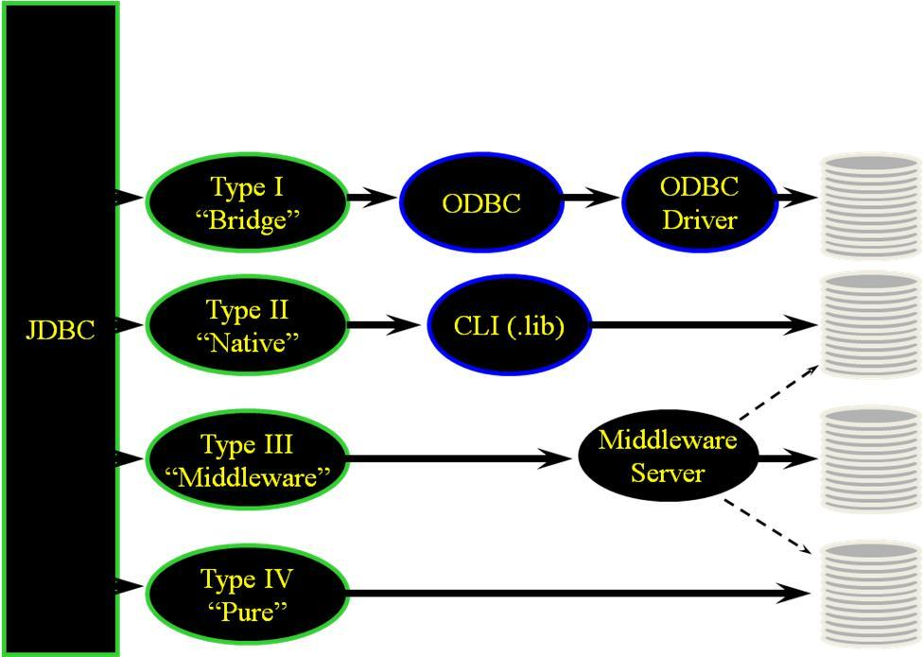

Slide 10

Questions?
Let us begin!

